Slide 1
Visual Question Answering
By
Santosh Yadav Jada
Harshil Lavjibhai Patel
Avni Mehta
Trinadha Rajeswari muppala

Slide 2
Objective
System Features
To implement the visual question answering system that would answer open ended free-form questions of natural language like English.
The model will be trained on thousands of images in order to extract the important features of these images using CNN and LSTM networks.
System will include a web application as an user interface.
User can either select an image from the available images or upload their own an image.
The user can then ask a free-form question about the selected image in natural language.
The system provides an accurate natural language answer in real-time.

Slide 3
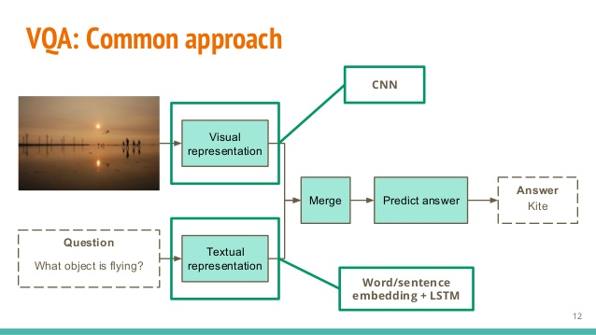
https://image.slidesharecdn.com/tfgisseymasudaoralpresentation-160715105427/95/openended-visual-questionanswering-12-638.jpg?cb=1468580130
Notes:
https://image.slidesharecdn.com/tfgisseymasudaoralpresentation-160715105427/95/openended-visual-questionanswering-12-638.jpg?cb=1468580130

Slide 4
Schedule
Increment 1:
Find a dataset (labeled/unlabeled data).
Preprocess and then set up the environment for development.
Increment 2:
Test already available model.
Change the parameters, models and try to get better accuracy.
Increment 3:
Development of web interface for using the trained model with test data.

